Slide 1

TEMPLATES IN C++
ARINDAM GHOSAL

Slide 2
Definition:
Templates are a mechanism that makes it possible to use one function or class to handle many different data types.
Templates are the foundation of generic programming, which involves writing code in a way that is independent of any particular type.

Slide 3
FUNCTION OVERLOADING :-
If we want to write a function that returns the minimum of 2 numbers passed to it , it will be a very simple function. But, if the parameters are different in different calls , then we will have to write multiple overloaded versions of it, as follows:-
int Min(int a, int b)//for integer type data
{
return (a<b)?a:b;
}
long Min(float a, float b) //for long type data
{
return (a<b) ?a:b;
}
char Min(char a, char b)//for character type data
{
return (a<b) ?a:b;
}

Slide 4
DISADVANTAGES OF MULTIPLE OVERLOADING:
Repetitive code in multiple functions.
Multiple function definition consume more disk space.
If we make a change in one function then we have to make the changes in other versions as well , making maintenance of the program tedious .

Slide 5
FUNCTION TEMPLATE SYNTAX
template <typename T>
T functionName(T parameter1, T parameter2, ...)
{
// code
}
Biggest advantage of the function templates is that the compiler generates only one version of the function for each data type irrespective of the number of calls that have been made for that type.

Slide 6
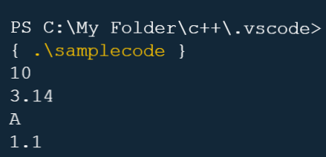
#include <iostream>
using namespace std;
template <class T>
T Min(T a, T b) // for integer type data
{
return (a < b) ? a : b;
}
int main()
{
int i = 10, j = 20;
cout << Min(i, j) << endl;
float a = 3.14, b = 6.28;
cout << Min(a, b) << endl;
char ch = 'A', dh = 'Z';
cout << Min(ch, dh) << endl;
double d = 1.1, e = 1.11;
cout << Min(d, e) << endl;
return 0;
}

Slide 7
EXPLANATION OF THE CODE IN THE PREVIOUS SLIDE:
The Min() function now works with a different data types that we use as arguments.
This is code reuse but of a different type, its reuse of the source code.
While in Inheritance and composition ,we reuse the object code. (Note::Source code is written by a programmer while an Object code is produced when a Source code is compiled)
Templates can significantly reduce source code size and increase code flexibility without reducing type safety.

Slide 8
CLASS TEMPLATES
Class templates specify how individual classes can be constructed so that every individual class supports similar operations on different data types.
Templates , therefore enable programmers to create abstract classes that define the behaviour of the class without actually knowing what data type will be handled by the class operations.

Slide 9
CLASS TEMPLATE SYNTAX
template <class T>
class className
{
private:
T var;
... .. ...
public:
T functionName(T arg);
... .. ...
};
className<dataType> classObject;
className<int> classObject;
className<float> classObject;
className<string> classObject;

Slide 10
DEFINING A CLASS MEMBER OUTSIDE THE CLASS TEMPLATE
Suppose we need to define a function outside of the class template.
We can do this with the following code:
template <class T>
class ClassName {
... .. ...
// Function prototype
returnType functionName();
};
// Function definition
template <class T>
returnType ClassName<T>::functionName() {
// code
}

Slide 11
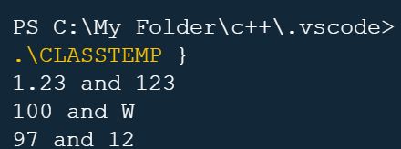
#include<iostream>
using namespace std;
template <class T1=int, class T2=int>
class Test
{
T1 a;
T2 b;
public:
Test(T1 x, T2 y)
{
a=x;
b=y;
}
void show()
{
cout<<a<<" and "<<b<<"\n";
}
};
int main()
{
Test <float,int> test1(1.23,123);
Test <int,char> test2(100,'W');
Test <> test3('a',12.635);
test1.show();
test2.show();
test3.show();
return 0;
}
OUTPUT-

Slide 12
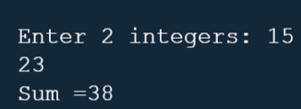
PROGRAM HAVING CLASS MEMBER DEFINED OUTSIDE CLASS:-
#include<iostream>
using namespace std;
template<class t>
class Test
{
t a, b;
public:
void get(){
cin>>a>>b;
}
t Sum();
};
template <class t>
t Test <t>::Sum()
{
return a+b;
}
int main()
{
Test<int>t1;
cout<<"\nEnter 2 integers: ";
t1.get();
cout<<"Sum ="<< t1.Sum();
return 0;
}
OUTPUT-

